Slide 1
Design of a Binary to Gray Code Converter Using Logisim
Digital Design and Computer Architecture (DDCA) — Project Presentation
Department : Freshman Engineering Department
Group : 6
KAKARAPARTI JOSHITHA SAI SAHASRA - 2620030378
PARUCHURI PRANAVI - 2620030409
KOMATIREDDY SAWNTHAN REDDY - 2620030437
MEREDDY SRI VARSHITH REDDY - 2620030438

Slide 2
Introduction to Binary and Gray Code
Key Concepts
3-Bit Binary to Gray Code Comparison
Decimal | Binary | Gray Code
0 | 000 | 000
1 | 001 | 001
2 | 010 | 011
3 | 011 | 010
4 | 100 | 110
5 | 101 | 111
Binary Code
Gray Code
Represents numbers using only 0s and 1s.
A binary encoding where consecutive values differ by only one bit.
Advantage
Converter
Reduces ambiguity caused by multiple bits changing simultaneously.
Transforms a binary input into its corresponding Gray code output.

Slide 3

Project Objectives and Logic Design
Objectives
Inputs & Outputs
1
Design a 4-bit binary-to-Gray code converter
Binary inputs: B3, B2, B1, B0 → Gray outputs: G3, G2, G1, G0
Boolean Expressions
2
Derive Boolean expressions
G3 = B3
G2 = B3 ⊕ B2
3
Implement using XOR gates in Logisim
Direct pass-through
XOR of B3 and B2
4
Verify outputs using the truth table
G1 = B2 ⊕ B1
G0 = B1 ⊕ B0
XOR of B2 and B1
XOR of B1 and B0
XOR outputs 1 when its two inputs are different.

Slide 4
Truth Table of the 4-Bit Converter
Dec | B3 | B2 | B1 | B0 | G3 | G2 | G1 | G0
0 | 0 | 0 | 0 | 0 | 0 | 0 | 0 | 0
1 | 0 | 0 | 0 | 1 | 0 | 0 | 0 | 1
2 | 0 | 0 | 1 | 0 | 0 | 0 | 1 | 1
3 | 0 | 0 | 1 | 1 | 0 | 0 | 1 | 0
4 | 0 | 1 | 0 | 0 | 0 | 1 | 1 | 0
5 | 0 | 1 | 0 | 1 | 0 | 1 | 1 | 1
6 | 0 | 1 | 1 | 0 | 0 | 1 | 0 | 0
7 | 0 | 1 | 1 | 1 | 0 | 1 | 0 | 1
8 | 1 | 0 | 0 | 0 | 1 | 1 | 0 | 0
9 | 1 | 0 | 0 | 1 | 1 | 1 | 0 | 1
10 | 1 | 0 | 1 | 0 | 1 | 1 | 1 | 1
11 | 1 | 0 | 1 | 1 | 1 | 1 | 1 | 0
12 | 1 | 1 | 0 | 0 | 1 | 0 | 1 | 0
13 | 1 | 1 | 0 | 1 | 1 | 0 | 1 | 1
14 | 1 | 1 | 1 | 0 | 1 | 0 | 0 | 0
15 | 1 | 1 | 1 | 1 | 1 | 0 | 0 | 1

Slide 5
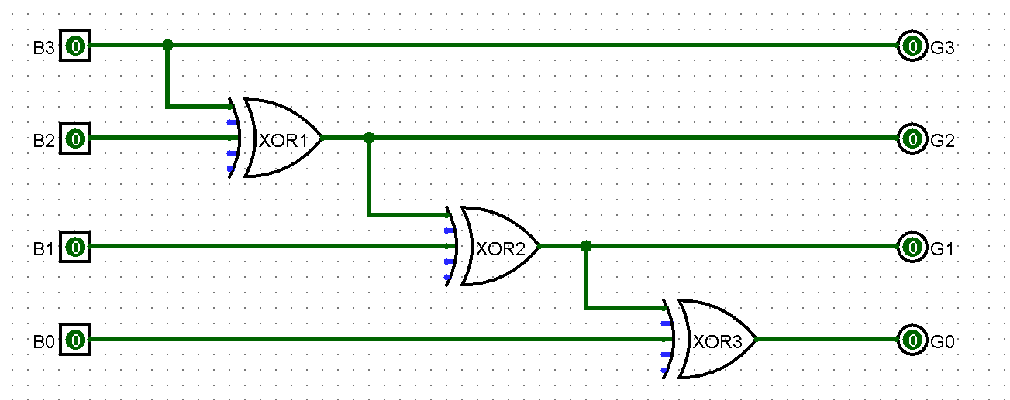

Circuit Implementation in Logisim
Circuit Architecture
The circuit is a combinational logic design requiring minimal components:
01
Direct Wire
B3 → G3: MSB is passed directly with no gate.
02
XOR Gate 1
B3 ⊕ B2 → G2
03
XOR Gate 2
B2 ⊕ B1 → G1
04
XOR Gate 3
B1 ⊕ B0 → G0
Three XOR gates and one direct connection are all that is needed for a complete 4-bit converter.

Slide 6




Working of the Converter
Circuit Operation
Worked Example
Binary input: 1011
B3 = 1, B2 = 0, B1 = 1, B0 = 1
G3 = B3
Directly copies the MSB.
G2 = B3 ⊕ B2
Gray code output: 1 1 1 0
XOR of the two most significant bits.
Verify by changing input switches in Logisim and comparing outputs against the truth table.
G1 = B2 ⊕ B1
XOR of the middle two bits.
G0 = B1 ⊕ B0
XOR of the two least significant bits.
G3 = 1
G2 = 1⊕0 = 1
G1 = 0⊕1 = 1
G0 = 1⊕1 = 0
Copy B3
B3 XOR B2
B2 XOR B1
B1 XOR B0

Slide 7
Applications and Conclusion
Real-World Applications
Conclusion
A 4-bit binary-to-Gray converter is a combinational logic circuit.
Rotary Encoders
Requires only one direct connection and three XOR gates.
Shaft and rotary position encoders in industrial machinery.
Boolean expressions define the conversion mathematically.
Position Measurement
The 16-row truth table verifies expected mapping for every input.
Digital position measurement systems requiring error-free transitions.
Logisim provides a convenient environment to implement and test the circuit.
Digital Electronics
Education and circuit simulation in digital design coursework.

